Slide 1
Project presentation on PADMA MULTIPURPOSE BRIDGE in 3d
Course Title: Engineering drawing Lab
Course Code: CSE-208 Section: 191Db
Presented By - Group 05
Umme Loara -191002187
Abu Yousuf Tamzid - 191002092
Mst. Mahmuda Akter Sumi -191002308
Department of CSE,
Green University of Bangladesh.
Presented To
Mr. Shabbir Mahmood
Lecturer,
Department of CSE,
Green University of Bangladesh.

Slide 2
Table of content
Introduction
Step to Goals
Design Goals
Main blocks
Rail Line Blocks
Road Blocks
Slope & Bridge
Overview of the Bridge
Practical Implications
Future scope of it

Slide 3
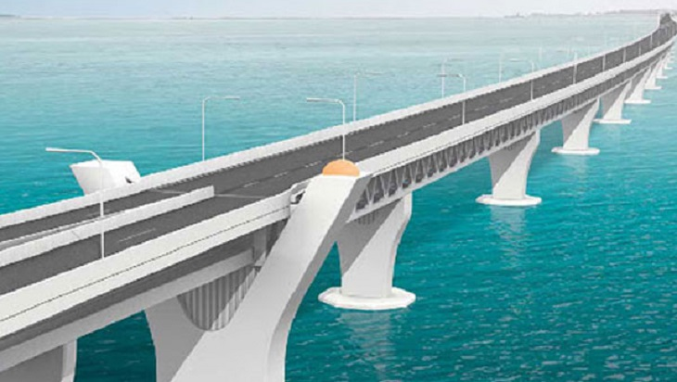
Introduction
In this project, we will try to summarize the construction of Padma Multipurpose Bridge using AutoCad. In this project, we use 13 span, 14 pillars for our project. It is a two-tiered steel truss bridge.

Slide 4
Step to Goals
Constructing Environment or demo model
Finding out proper measurement
Constructing structures
Implementing 3D model with measurement
Checking Measurement

Slide 5
DESIGN GOALS
To enrich our knowledge in AutoCad.
To enrich strong knowledge in 2D, 3D Modeling.
To develop the idea of Padma Multipurpose Bridge.
To gather knowledge of any type of Bridge.
To enrich our knowledge how a bridge can reduce traffic, save times, estimate cost.

Slide 6
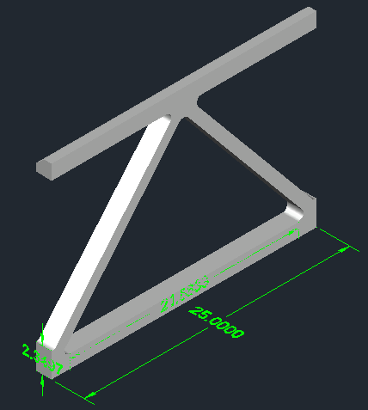
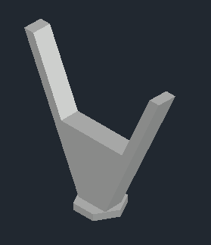
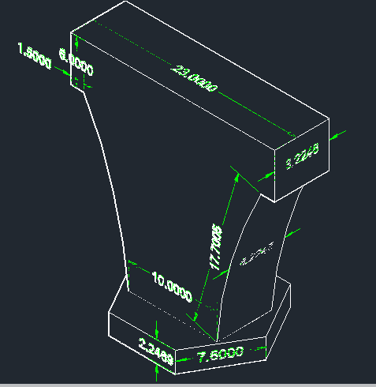
Main blocks
Fig-1: Span block
Fig-2: Pillar
Fig-3: Pillar with Annotation

Slide 7
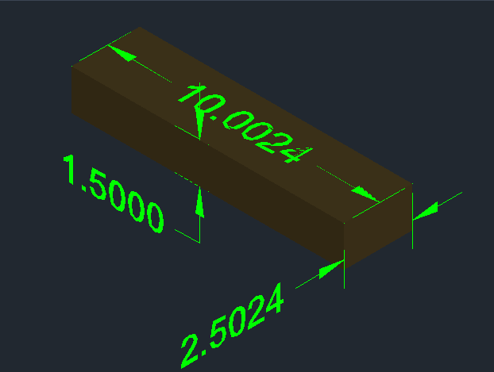
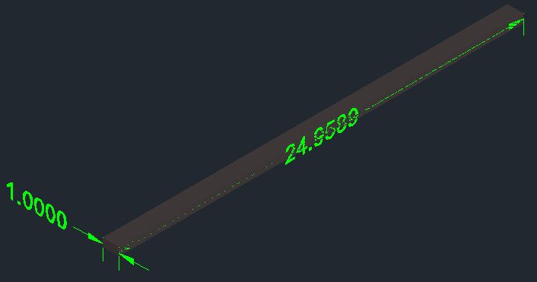
Rail line blocks
Fig-4: Sleeper
Fig-5: Rail

Slide 8
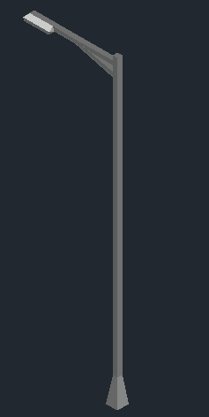
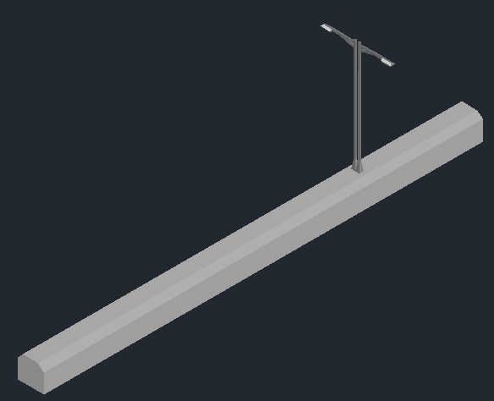
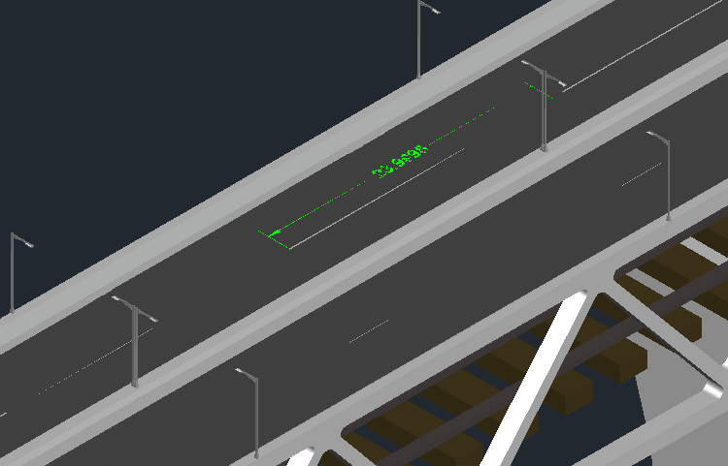
Road blocks
Fig-6: Traffic light
Fig-7: Traffic light with no U-turn
Fig-8: The 4-lane road

Slide 9
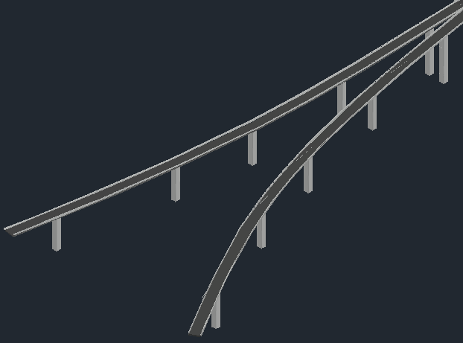
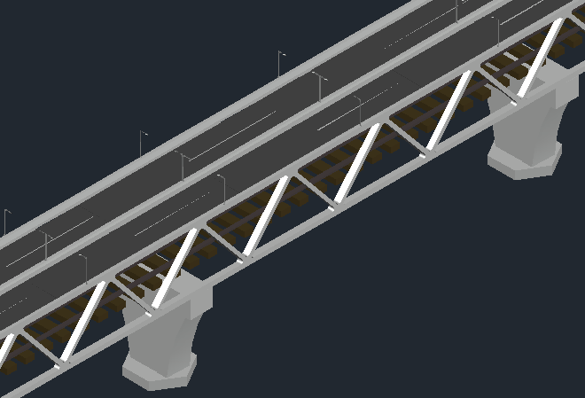
Slope & bridge
Fig-9: The sloping part
Fig-10: One part of the bridge

Slide 10
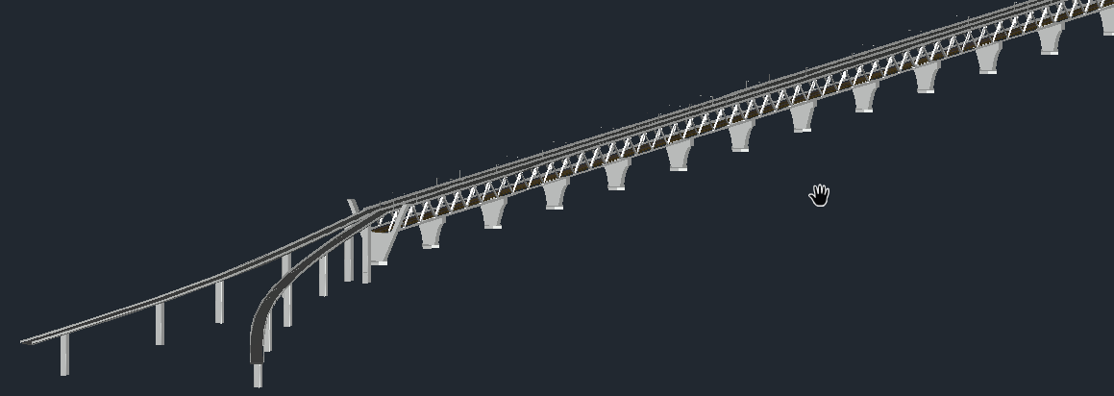
Overview of the Bridge
Fig-11:Half part of the Bridge

Slide 11
PRATICAL IMPLICATIONS
Can help a beginner to learn the basic of AutoCad 2D & 3D drawing.
Able to do another types of bridge & also able to make different types of drawing.
After constructing the project, the overall GDP of the country by more than 1.0 per cent.
Also after completing the project in real, the traffic will be reducing.

Slide 12
Future scope of it
Can do 2D, 3D design of other bridges in the same way
Be able to do many designs on our own
Increase GDP, reduce traffic, and reduce the risk of traveling on the river.
Can be used as economic corridors

Slide 13


